Slide 1
Debugging

Slide 2
Why?
What?
Fixing defects in code
Occurs throughout construction, testing and deployment stages
Chronic underestimation of coding time
always discount time spent debugging
Spend 30% to more than 50% of coding time debugging
Huge variation in debugging effectiveness
Best debuggers more than 10X faster than worst (or even average) debuggers

Slide 3
Debugging
NOT an art – a science
When it takes a long time it is invariably because some basic principle has been overlooked
People who are good at debugging intuitively understand and apply the rules.
The rules are : apply scientific process
Rules are obvious - BUT obvious doesn’t mean easy
Other methods:
Shotgun (otherwise known as ‘headless chicken’)
Change many things, all at once, without analysis
Exciting, but pretty much a waste of time
Voodoo programming
Just make changes and hope for the best
The ‘grind’
work back from the point of failure step by step until you find the bug, then fix it
Slow and boring – but WILL find the bug
Various ways to speed things up

Slide 4
Terminology
Bug – a defect in code
Defect causes infection
Infection propagates Infection results in failure
Infection propagates through a chain of dependences from the origin to the point of failure
Chain of dependences form a program slice

Slide 5
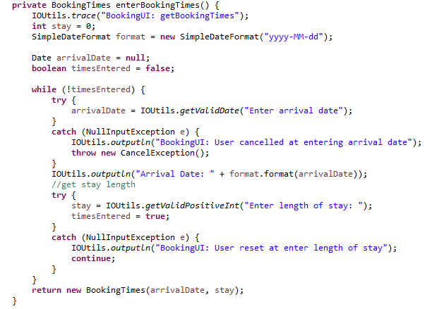
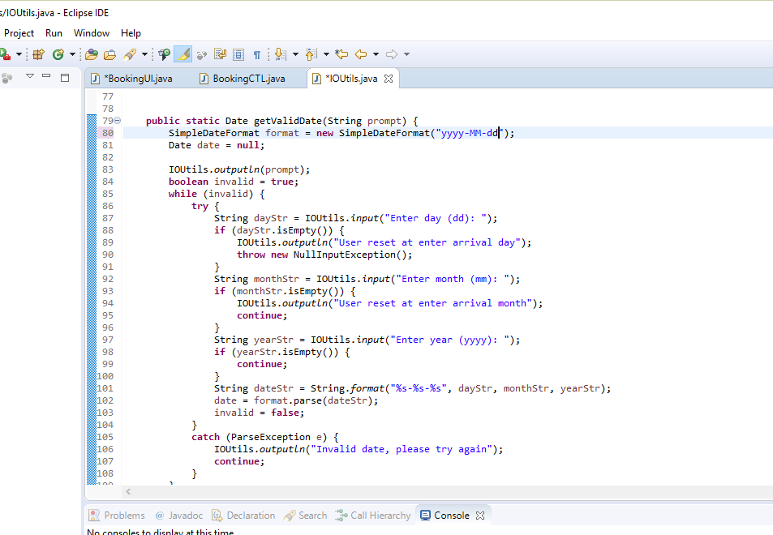
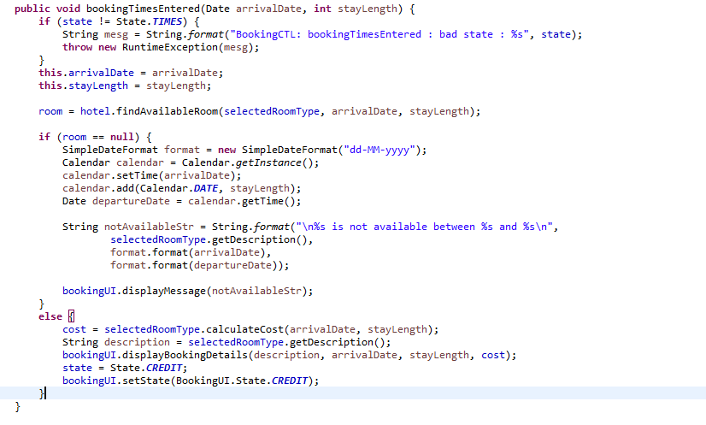
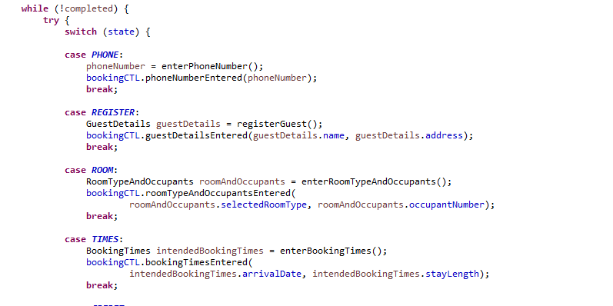
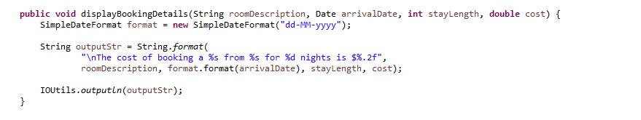
Terminology
Defect
Dependence Chain
Failure

Slide 6
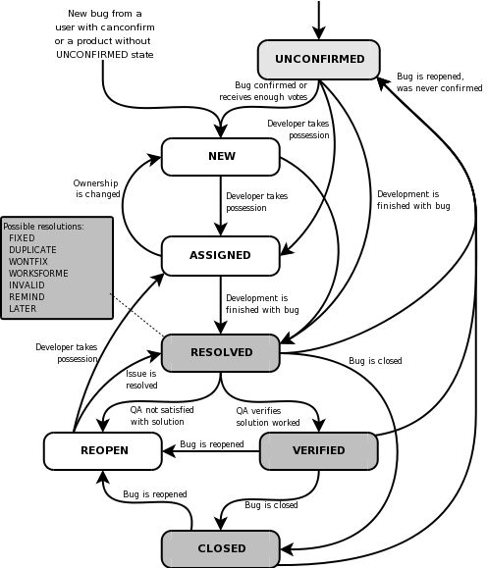
Life Cycle of a Bug
Prioritization
Blocker
Critical
Major
Normal
Minor
Trivial
Enhancement

Slide 7
Debugging Process
Reproduce
UAT
Simplify
Automated test
Isolate
Trace
Tools
Resolve
Validation
Test

Slide 8
Principles
Think – 20 Questions or Animal/Vegetable/Mineral
don’t ask the specific questions first
narrow things down
Basic premise
- you are wrong
– if you were right, there wouldn’t be a bug
- something somewhere in what you think you know is wrong
- check your assumptions

Slide 9
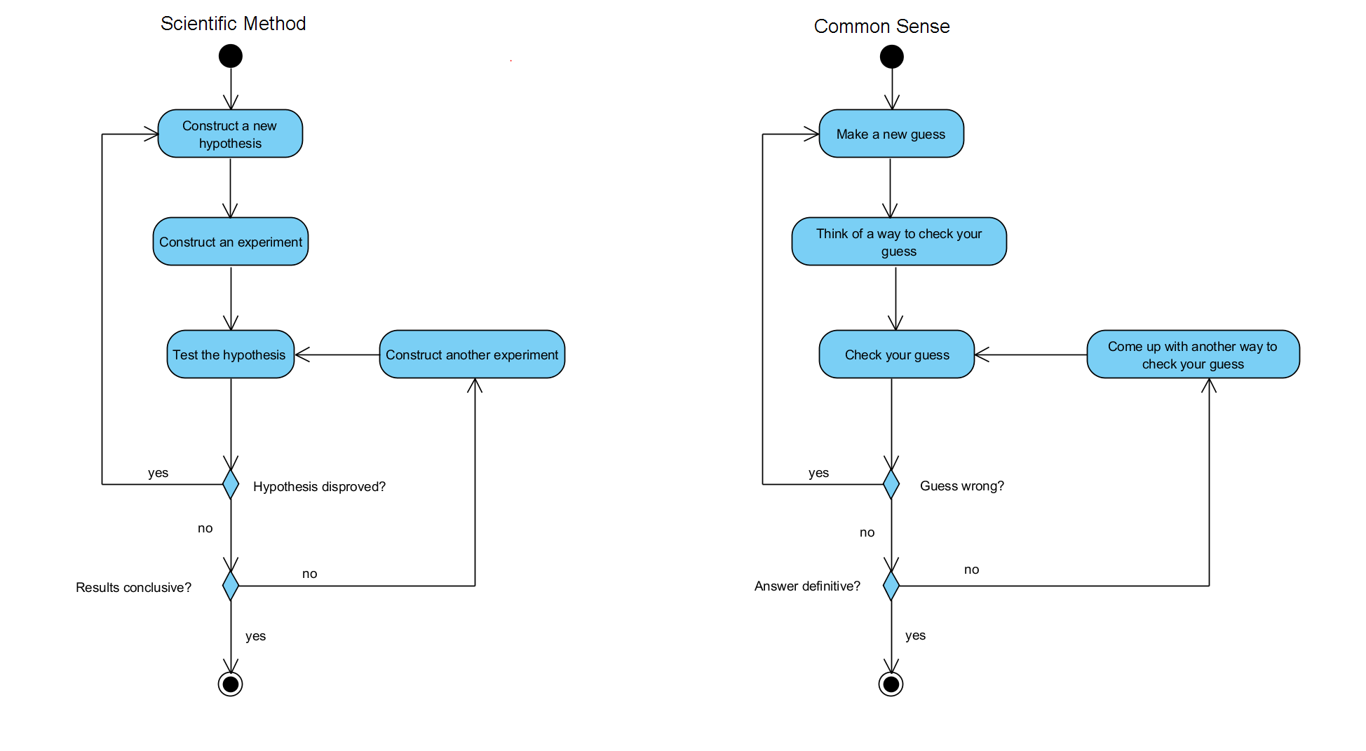
Scientific Method

Slide 10
Principles
Understand the system
Make it fail
Quit thinking and look
Divide and conquer
Change one thing at a time
Keep an audit trail
Check the plug
Get a fresh view
If you didn't fix it, it ain't fixed.

Slide 11
Principle 1. Understand the system
Sometimes, its a feature not a bug - ie its behaving the way its meant to, but you just don't understand what that is
Read the manual - thoroughly
Understand the basic principles - know what’s reasonable
Understand how things are connected and how they are meant to interact
Understand your tools
Google is your friend - look it up

Slide 12
Principle 2. Make it Fail
“there is nothing like first hand evidence”
Do it again
so you can see what happens when it fails
so you can see what happens leading up to the failure
so you can see if you fixed it
Start at the beginning
You need to know ALL the circumstances, not just some of them or just the 'relevant' ones
Stimulate the failure - replicate the failure conditions
Dont simulate the failure - trouble is you aren't looking at the actual bug
Caveat - if same bug appears on a different system, it is likely to be a design bug rather than a configuration issue
What if its intermittent?
Bad luck - Keep trying to make it fail while varying a lot of conditions until it does fail again, and note down the conditions (and lead up) to when it does fail - ie try to make it not intermittent, try to make it predictable.
Logs help
Be wary of coincidences - you want 'always' and 'never', not 'sometimes’
'but that can't happen' - always reveals ignorance - 'that' clearly IS happening, you just don't understand exactly how - so find out

Slide 13
Principle 3. Quit thinking and look
“it is a mistake to theorise without evidence”
check your assumptions.
Logic is all very well - but if its based on a faulty ASSUMPTION then it won't tell you anything useful
Bugs are inevitably due to faulty assumptions – i.e. something SHOULD work - but it doesn't. If all the assumptions were correct, then it WOULD work.
See the failure in detail
instrument the system - but be careful the instrumentation doesn’t mask the bug
Guess to focus the search - guessing is fine - if your guess is based on ALL available information, and you CHECK your guess.

Slide 14
Principle 4. Divide and conquer
“when you have eliminated the impossible, whatever remains, however improbable, must be the truth”
Narrow the search - this is the only way to find the bug
check values at functions calls - good in, bad out - problem is in function
check values half way through long sections of code - (binary split) - bad values - problem is before, good values - problem is after. Keep doing that (Binary search).
use test values that generate results which are easy to check
Start at the bad end
start where the problem occurs and work BACKWARDS until you get to a point where the problem doesn't exist. Just after that is where the problem occurs.
Fix the problems that are obvious
Sometimes there is more than one problem. Sometimes problems interact. Sometimes fixing one problem fixes the other. Sometimes 'fixing' one bug without fixing the other, doesn't actually fix the first bug, but introduces another bug.
Eliminate things that cause randomness

Slide 15
Principle 5. Change one thing at a time
“genius is an infinite capacity for taking pains”
If you change more than one thing then you can't tell what change caused what effect - so you cant reason about the changes
Don't panic. Stop and think, come up with a theory, change one thing to test that theory. DON'T just make a few changes to see what happens
Compare with something that works - and spot the difference in setup/configuration/input values
What was the last thing you changed? (and have you been following good version control practice)

Slide 16
Principle 6. Keep an audit trail
“the shortest pencil is longer than the longest memory”
Keep track of everything you did, in what order, and what happened (reporting bugs)
- Often the key is in some obscure detail
- Correlate symptoms - they are giving you a clue (see 'guessing' above)
Version control can be useful in identifying what has changed
People forget, people make mistakes, people misremember - pencils don’t.

Slide 17
Principle 7. Check the plug
“there is nothing more deceptive than an obvious fact”
“convictions are more dangerous enemies of truth than lies”
Don’t overlook the obvious - check your assumptions
Dont start checking from the middle - check things from the beginning
Check your tool - cf debugging your unit tests

Slide 18
Principle 8. Get a fresh view
“Nothing clears up a case so much as stating it to another person”
Just stating it can force you to acknowedge your assumptions or see the error in your logic.
The other person may know what the problem is
The other person may have a different perspective that lets them see the problem
Two heads are better than one
Don-t be proud - ask for help
apply the two hour rule:
- if you have been bashing your head against a wall for two hours - stop and get help
- also, you aren't doing it properly because if you were you would be making progress
- so stop wasting your time(and maybe other people's) and get help.
report symptoms not theories - ie report what you did, what happened, and what you observed, not what you think is happening.
report everything - don't exclude information becasue you don't think its important or irrelevant
- remember that the thing about a bug is that its an indication that you have made a MISTAKE - so your judgement isn't necessarily the best guide as to what is important

Slide 19
Principle 9. If you didn't fix it, its still broken
Check that its really fixed - see rule 2. That shouldn't work any more.
Explain how you fixed it - if you can't explain how what you did fixed the problem, then you probably haven't fixed the problem.
- take your fix out and see if the problem comes back
put your fix back in and see if the problem goes away again
problems NEVER go away by themselves - something ALWAYS makes them go away - so what was it?
Murphy’s Law is a killer - problems that just 'go away' ALWAYS come back - usually during an important demo.
Don’t fix symptoms - fix causes - never fix a bug by inserting a 'workaround' for some condition occurring that should never occur - track down why the condition IS occurring.
Fix your process - if there is a pattern in what sort of bugs are occurring, maybe there is something in the way you doing things that is wrong.
- like maybe not thinking things out before you start to code?

Slide 20
Stanford Guidelines
Intuition is great – just test it (Principle 3, 7)
Don’t overlook the obvious – most bugs are typos (Principle 3, 7)
Work from facts (Principle 3)
Be systematic and persistent (Principles 5, 6, 7)
Test often (and commit) - look at the last thing you changed (Principle 5)
Don’t change code randomly while tracking a bug (Principle 5)
But do fix clear errors that you come across while tracing bugs (Principle ?) - debateable
If you cant explain clearly what the bug was and why what you did fixed it – you haven’t found or fixed it. (Principle 9)
Check your assumptions and beliefs. 2 minutes of testing and checking can avoid hours of pointless searching. (Principle 3, 7)
Follow your hunches – but test them (Principle 5, 6)
Don’t work continuously after it has become non-productive – take a break, sleep on it, get a fresh perspective (Principle 8)

